Slide 1
User Data Protection In machine learning models
Karthik G N, Chanchal Sahu, Vikas Vardhan Soni, Naman Gupta
Mentor : DESHMUKH SUDARSHAN S

Slide 2
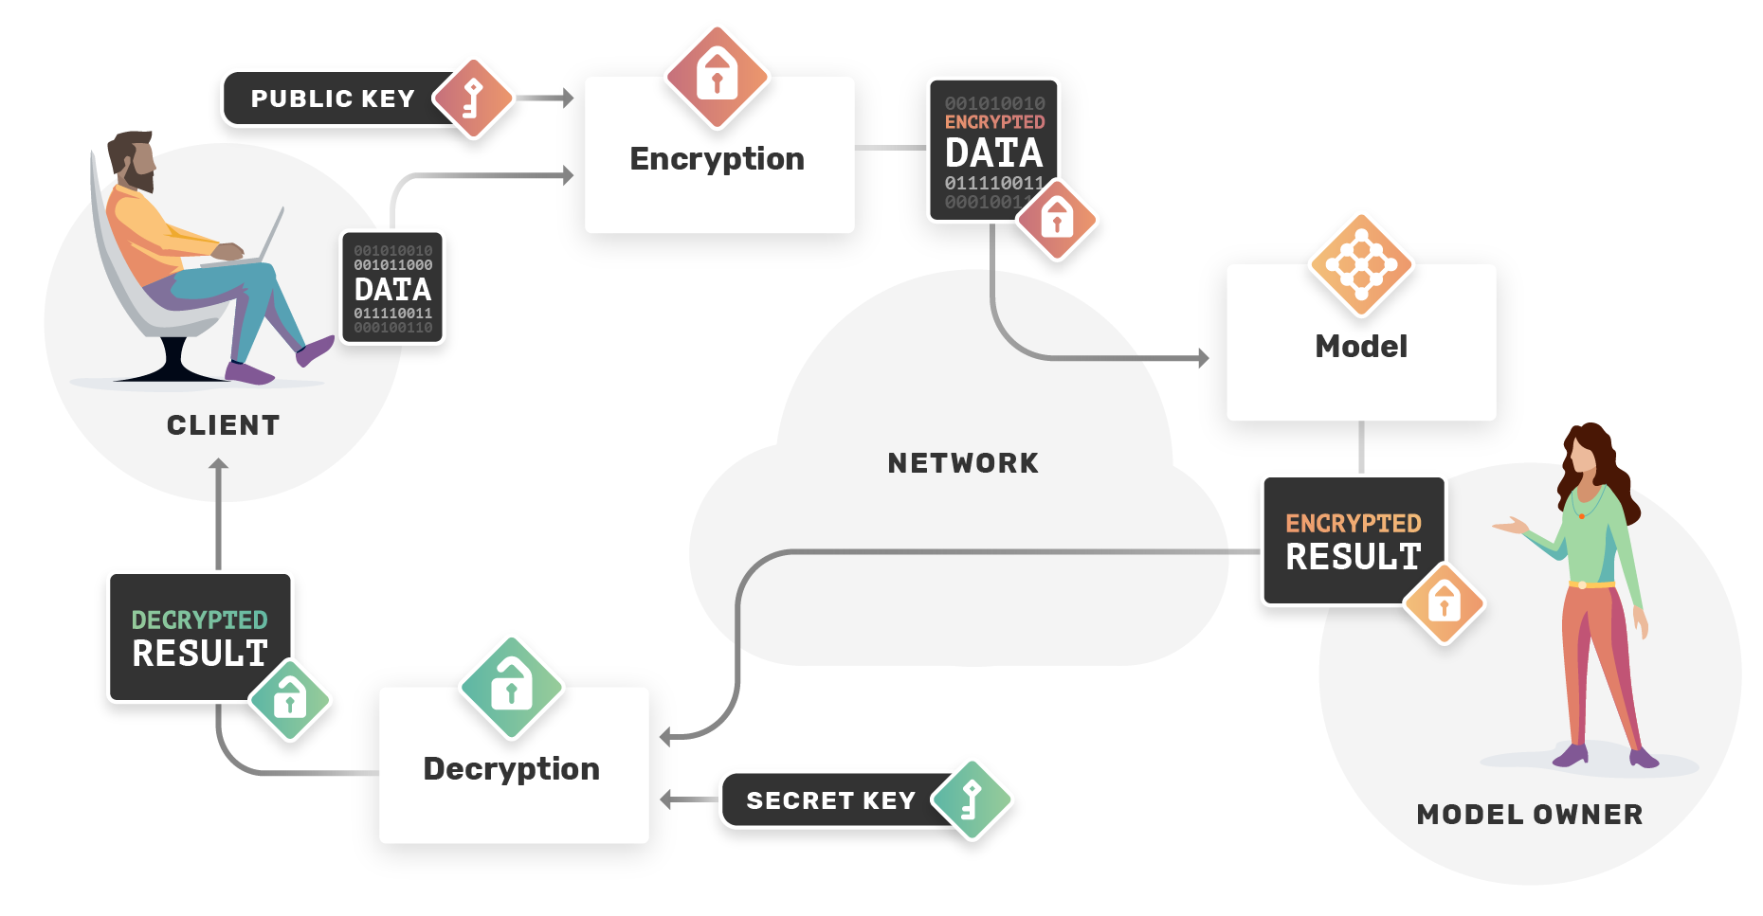
Problem Statement:
Develop a privacy-preserving machine learning model for credit risk assessment in banking.

Slide 3
Approach
EDA & Encryption
Reading given input German data
Encrypt Client’s German data using standard encryption like SHA 256, Tenseal, PySeal
Generator
Build Vendor Encoder Model with the encrypted sample noise
Discriminator
Build Vendor Decoder Model with the encrypted training data
GAN Model Building
Decoder to pass on the cost function to encoder
Encoder to understand the awareness of the prediction from the cost function value and to retrain itself
Repeat this process until cost function is Optimized
Deploy & Test Model
Implement and deploy a batch process to test the deployed GAN model with encrypted data from API endpoint(Deploy for inference)
Tune the hyper parameters to get optimized results
Build API end point to provide test data

Slide 4
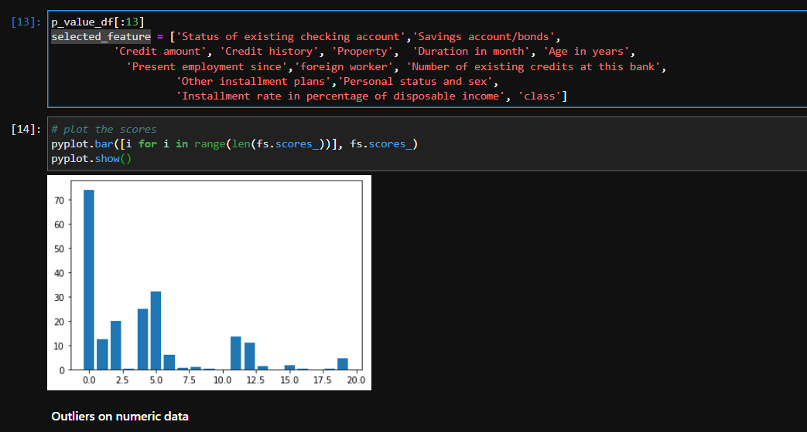
Task Accomplished
Week 1-2: Exploratory data analysis
Data Structure analysis
Outlier detection for numerical features
Feature Selection using Chi Square method
Approach Selected : Label encoding for Categorical and Binning for Numeric Data

Slide 5
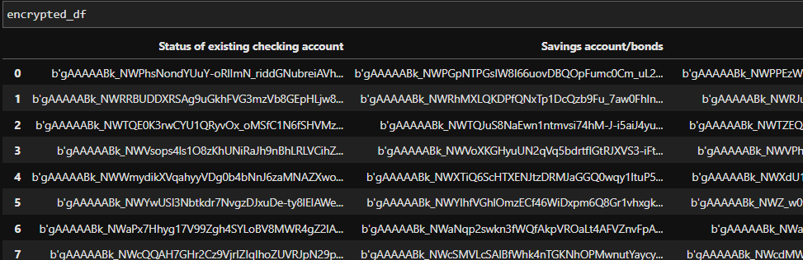
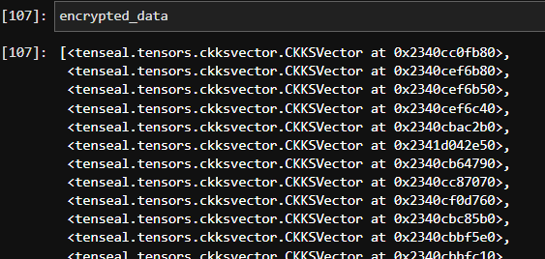
Task Accomplished
Week 3: Privacy-Preserving machine learning techniques
Homomorphic Encryption
Libraries evaluated : Tenseal, Seal, PySeal
Encryption Techniques evaluated : CKKS, Paillier
Differential Privacy
diffprivlib
Other Encryption Libraries
Fernet, MultiFernet, Cryptography
Approach Selected : Cryptography with Hazmat Layer

Slide 6
Task Accomplished
Week 4: Training GAN Model
Define Generator
LeakyReLU
Sigmoid Activation
binary_crossentropy Loss Function
Adam Optimizer
Define discriminator
LeakyReLU
Dropout
binary_crossentropy Loss Function
Adam Optimizer
Define GAN
Train GAN model
Testing the GAN
Building and Training the Binary Classifier with DL NN
Exposing the API and Tuning the Model

Slide 7
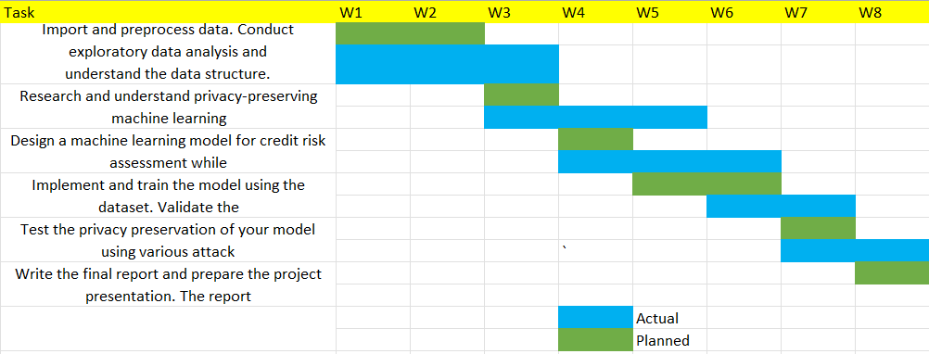
Milestones

Slide 8
Data Encryption
Approaches we tried for data encryption:
Fully Homomorphic encryption using TenSeal, PySeal libraries
Partial homomorphic encryption using Paillier library
Fernet encryption
Deterministic encryption with Cryptography library and hazmat layer
Key findings
Homomorphic encryption will not work for our case as we planned to use neural networks for classification. Output from both CKKS and Paillier encryption cannot be fed into Neural network.
Fernet based encryption was not deterministic and thus cased different encryption strings to be generated. This increased complexity of the model for us as hot encoding increased the number of input columns.
Finally, we agreed to use a deterministic encryption with Cryptography library which has a predefined initialization salt value so that encryption is always consistent.

Slide 9
GAN Modelling
Exploration using GAN generated data
We were able to create GAN which was trained to generate synthetic data. In case of class imbalance issues, clients should be able to generate synthetic data which will improve overall training and prediction.
GAN based model that is trained to generate real looking data. This was built to check the performance of the classifier as well as to corroborate the test data when any kind of class imbalance is there on the training data.
We used torch library to build a classification model that trains on the German data. The model was eventually tested upon test German data.
We saw GAN loss decreasing as we increased the number of epochs. Similarly, with reducing learning rates we saw GAN performance improving and we got the best prediction with hyperparameter as learning_rate=0.0000001, beta_1=0.3, beta_2=0.5.

Slide 10
Binary Classifier Modelling
Total 5 layers (Input + Output + 3 hidden layers)
Activation function, Relu for input and hidden layers, Sigmoid for the output layer
Output layer as only one node, because it generated a binary credit risk with sigmoid activation function.
Loss function used is binary cross entropy loss as we have binary classification of the output label.
We are using Stochastic Gradient Descent as an optimizer with a learning rate of .05. We started with a learning rate of .001 but finally got best value at .05 with maximum loss minimization SGD is used because it provides good performance with deep neural networks.
The model was trained with 1000 epoch on the training data generating around 75% plus accuracy.

Slide 11
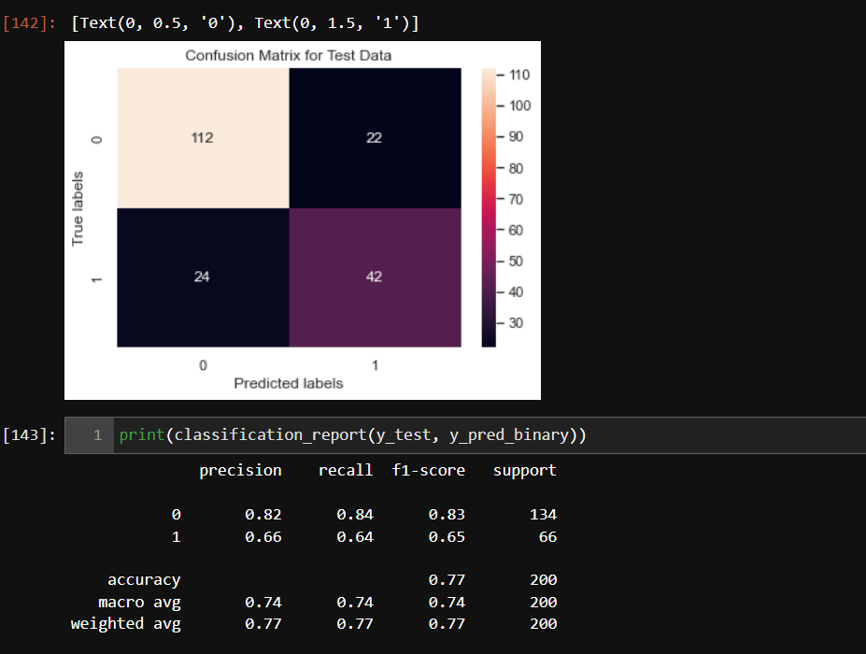
Metrics

Slide 12
Running the API

Slide 13
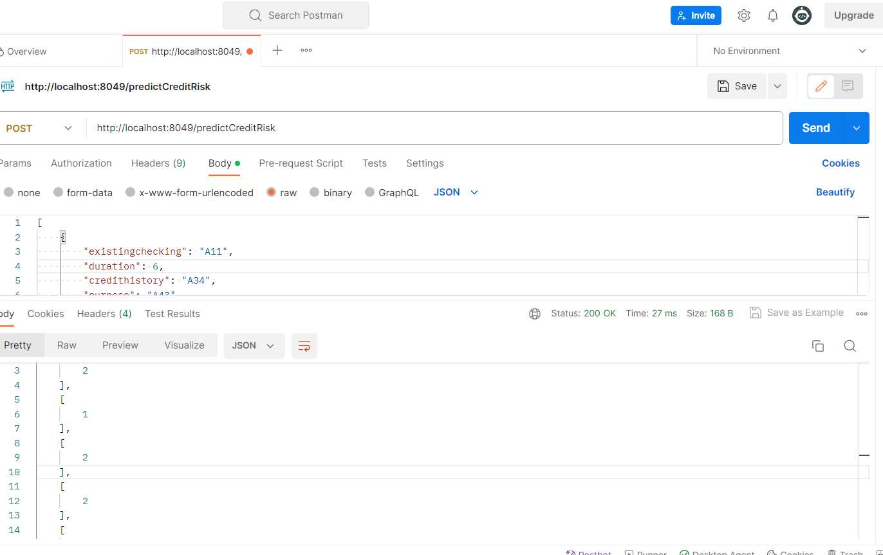
Testing API Via Postman

Slide 14
Thank You

